Slide 2




Don’t Do illegal Shit!

Slide 3
Preface
Let me preface this post with: I began writing confused of how complex rootkits seemed. In-fact, it was my motivator for writing this.
However, while creating these slides, it became apparent how straightforward* they can be.
* (rootkits may not always be straightforward)

Slide 4
The aims of this session
I want to give everyone here a working overview of rootkits in general, in terms of:
How they might be classified (are they always malicious?)
How well they can persist
Specific and current examples of threats

Slide 5
Classifying a rootkit (what is a rootkit)
In modern terms, a rootkit is malicious software that maintains privileged access to a system, while hiding evidence of its existence from users.
Notably, it is just a tool for stealthy, high-level persistence.
We can attribute the 'root' to standard unix systems most privileged user being root, and 'kit' to the fact that rootkits are usually one part of a malware campaign, ‘a tool within a kit’.
Essentially, a rootkit is a tool (or collection of tools) used to keep high-level persistence on a system.
Notes:
Does everybody understand what persistence is?
And what privileged access means?

Slide 6
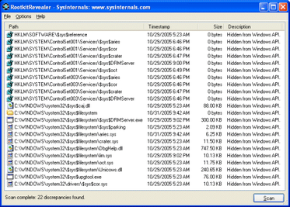
Rootkits aren’t always malicious
Before we begin, rootkits may not be malicious, although that is what this talk will focus on.
Some examples of non-malicious rootkits include:
SONY anti-piracy rootkit. intercepting all accesses of the CD drive to prevent any media player or ripper software other than the one included with XCP-Aurora from accessing the music tracks of the Sony CD.
(although I suppose this should be classed as malicious, because users were not warned this rootkit would be installed)
Notes:
And I suppose this can be considered privileged access, it’s hiding processes from the user.

Slide 7
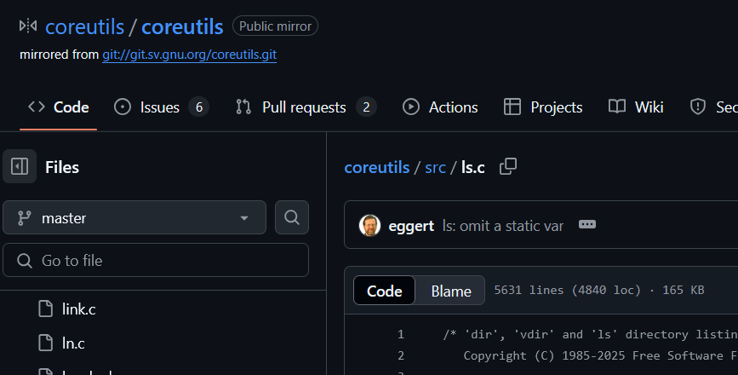
Types of rootkit
User mode
User mode rootkits replace things at a level called ‘user space’, which is what things like your apps / binaries (web browser etc.) run in.
A rootkit here could look like system utilities being swapped (ls, cat, find) with copies that function the same to the user, but perform actions that benefit the person who placed the new infected utilities
Notes:
How many of you know how to check these basic sys binaries?

Slide 8

Types of rootkit
Kernel mode
The kernel is where things get hard to describe, so instead just imagine it as a concept.
This concept being: a middleman between user mode applications.
For example, the ‘top’ command in linux.

Slide 9
Types of rootkit
Kernel mode
For example, the ‘top’ command in linux.
It finds directories using (I believe) ‘getdents()’ syscalls. Specifically by reading the /proc/ directory.
A rootkit in the kernel could alter the info that is returned by syscalls used by ‘top’, hiding processes from being shown.

Slide 10
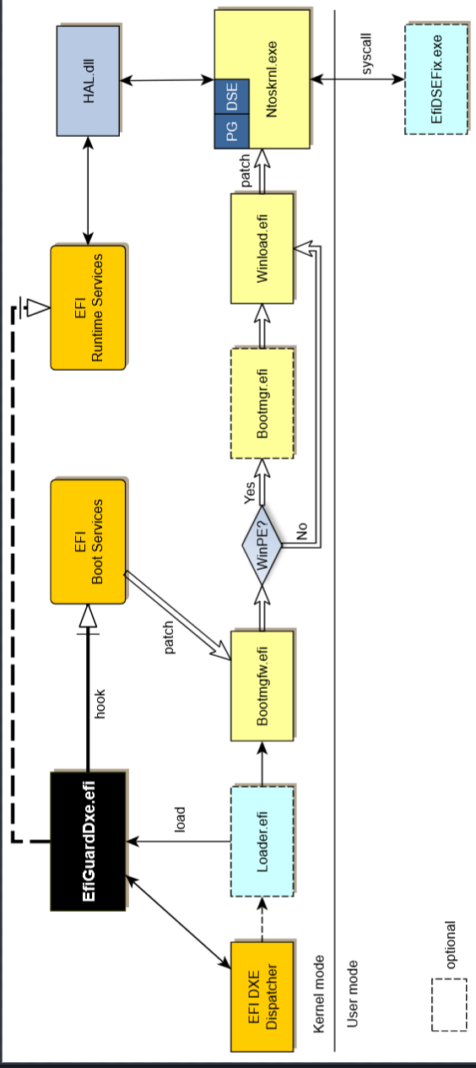

Types of rootkit
Bootkits
Bootkits are a type of rootkit that infect the system's firmware, specifically the UEFI (Unified Extensible Firmware Interface) or, in older systems, the BIOS (Basic Input/Output System). This infection occurs at a very early stage of the boot process, making the bootkit one of the first pieces of code executed when the computer starts, even before the operating system loads. (we will have an example of this later)
As it loads so early, there are few protection measures and plenty of chances to gain persistence, and removal as such is essentially impossible for the average person.

Slide 11
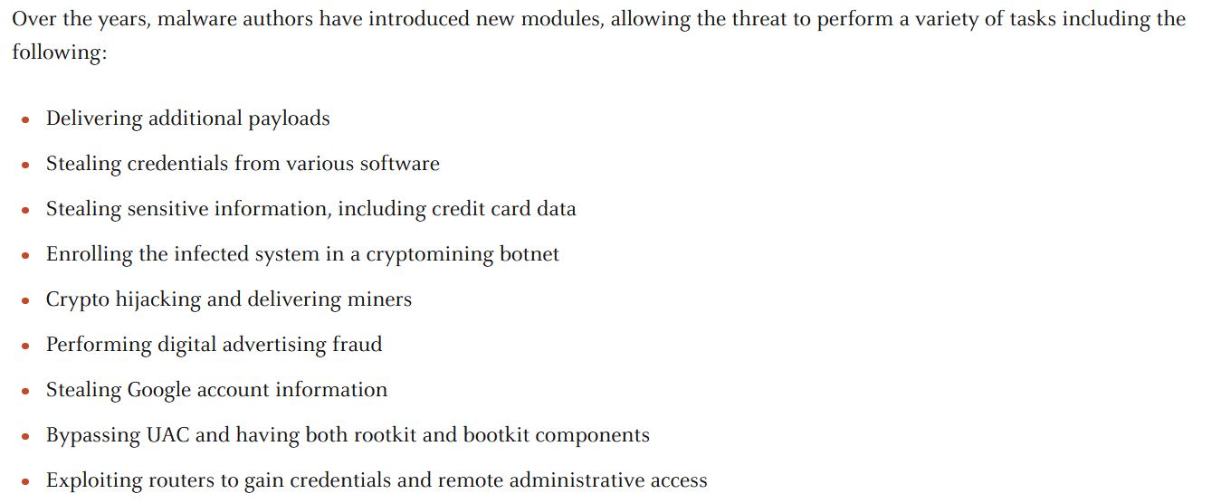
Current rootkit examples
Glupteba's UEFI Bootkit - 2024 - Unit 42:
Notes:
Note that this is some of the damage it can do.

Slide 12
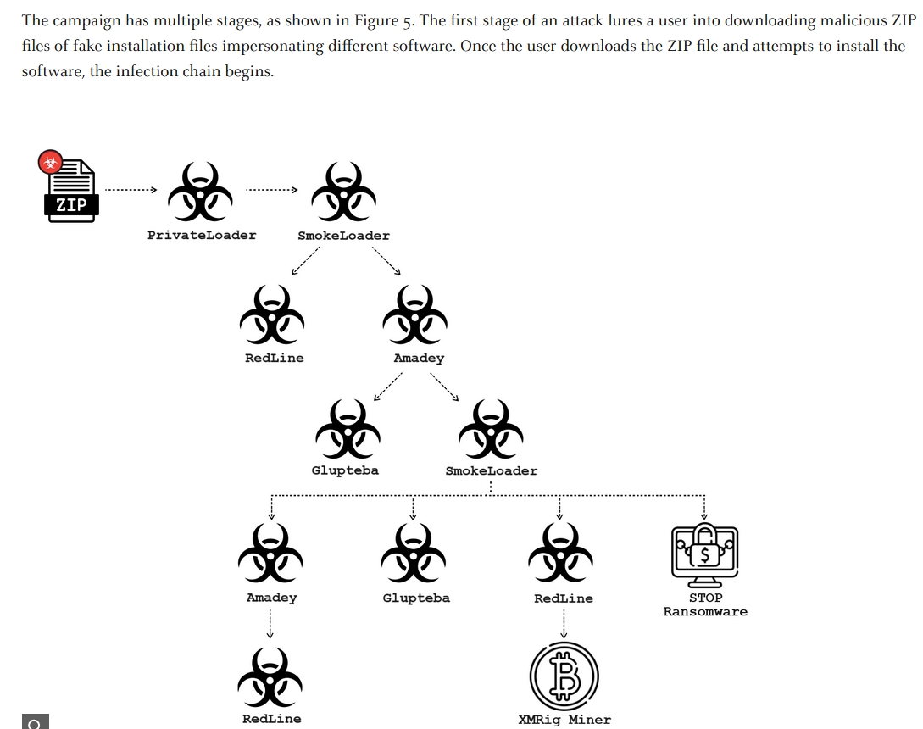
Current rootkit examples
Glupteba's UEFI Bootkit - 2024 - Unit 42:
Notes:
Like I mentioned earlier, just a tool in a larger campaign

Slide 13
Quick tangent
Glupteba's UEFI Bootkit - 2024 - Unit 42:
Can anyone think why Glupteba would need all those features in one bit of malware?

Slide 14
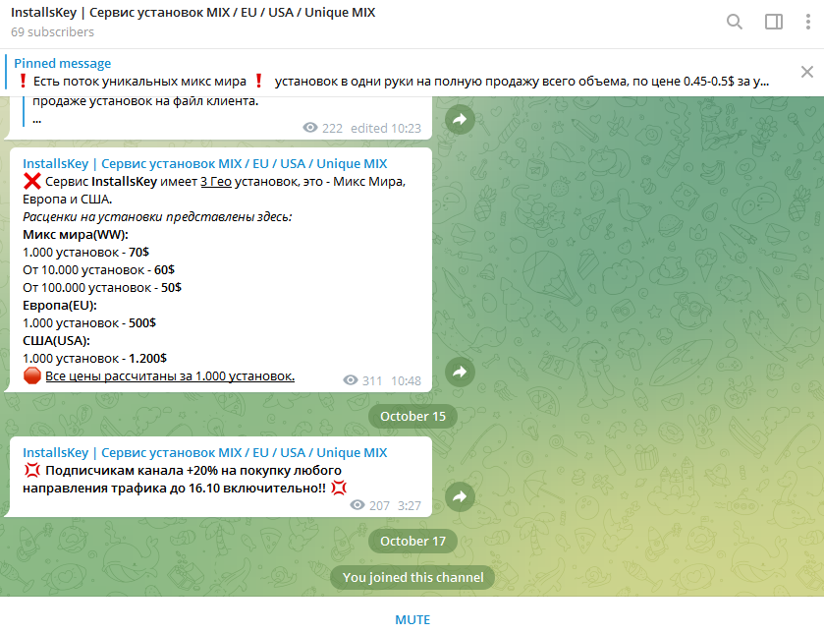
Glupteba's UEFI Bootkit - 2024 - Unit 42:
That’s right! They employ a ‘pay per install’ model:

Slide 15
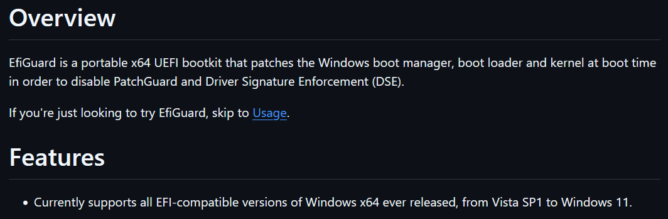
Glupteba's UEFI Bootkit - 2024 - Unit 42:
Anyway, their rootkit.
A key point:
It uses an open-source UEFI bootkit
Notes:
Did I explain UEFI

Slide 16
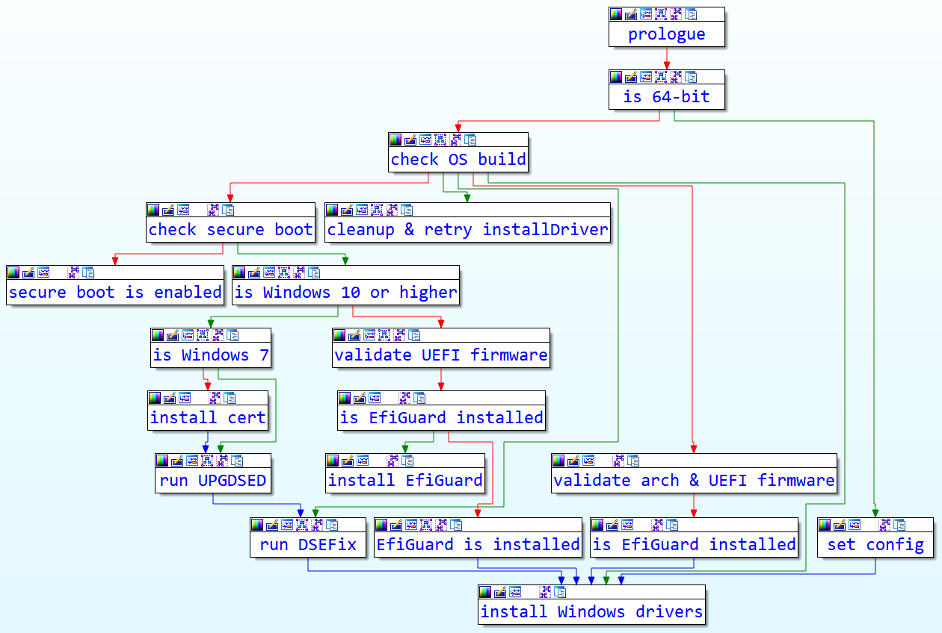
Glupteba's UEFI Bootkit - 2024 - Unit 42:
It does all of this to install vulnerable drivers
Which run at the kernel level
= ez kernel rootkit

Slide 17
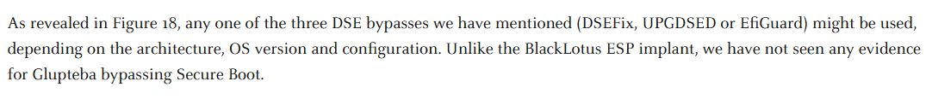
Glupteba's UEFI Bootkit - 2024 - Unit 42:
Mitigating this windows firmware bootkit
Seemingly, secure boot can mitigate this threat, and windows defender operates at the same level of Glupteba. Meaning detection (and removal) is relatively possible.

Slide 18
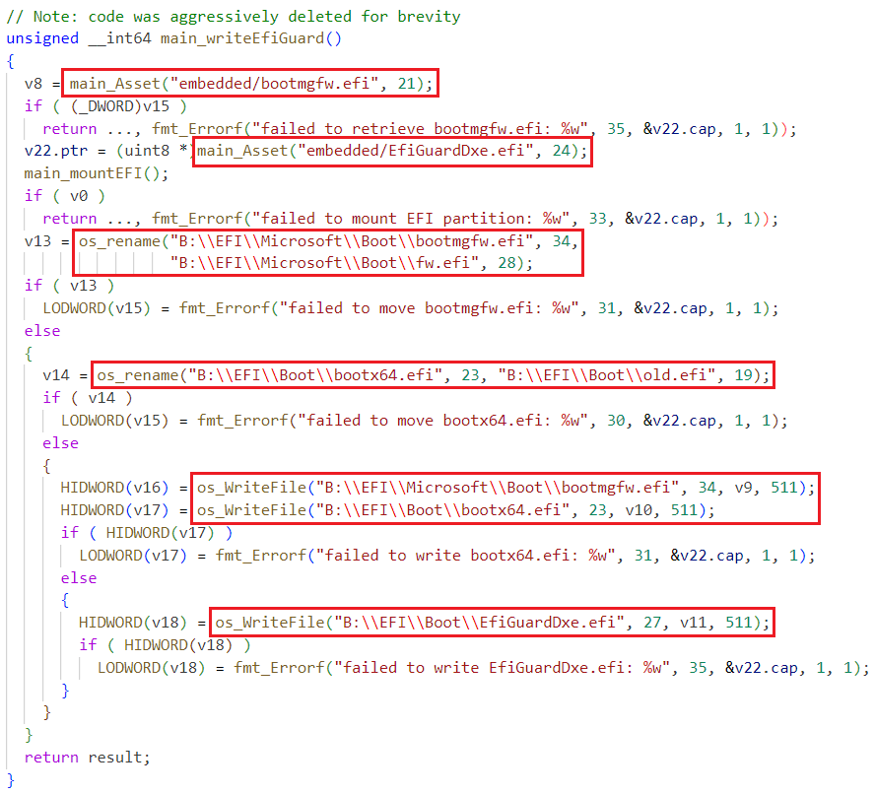
The bootkit was discovered through code analysis with a disassembler, giveaway strings such as this were found:
Notes:
This was obvs after unpacking the binary

Slide 19
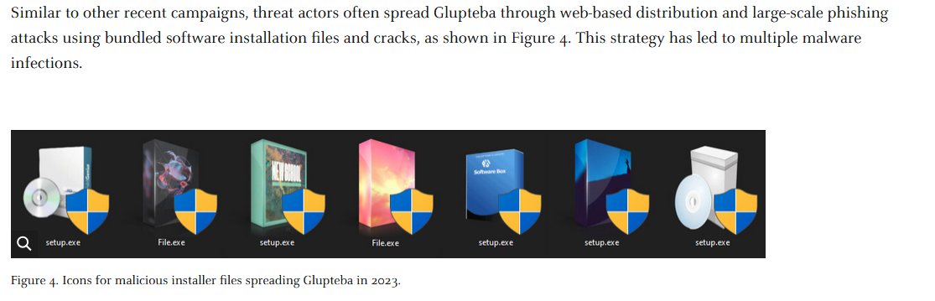
Installing a rootkit
As with all malware, rootkits are mostly installed via social engineering. In more sophisticated cases it could be caused by an unknown bug/vulnerability. But this is unusual.
Notes:
This was obvs after unpacking the binary

Slide 20
What did we learn?
Rootkits are not always ‘malicious’, even if I don’t agree with them.
What a rootkit is.
What a rootkit does/can do at different levels of privilege (kernel or user mode).
Rootkits are simply a part of a larger scheme, when it comes to malware.
The Glupteba malware campaign used a ‘UEFI’ rootkit, which happens to be open source. Meaning you can too! (but don’t because that’s illegal, if used maliciously)
Notes:
This was obvs after unpacking the binary

Slide 21

Your turn!
Task 1: create a malicious ‘cat’ binary and replace with the original binary.
Task 2: Find a tool online that can detect that this binary is modified. (there are many, feel free to ask for hints if stuck)
Task 3: Replace the, now malicious, binary with a fresh and official / safe to use tool. (get it back to normal)

Slide 22
Please visit
https://unit42.paloaltonetworks.com/glupteba-malware-uefi-bootkit/
https://www.youtube.com/watch?v=AZqKVhPiSoc

